Slide 1

TEXT SUMMARIZATION USING NLP APPROACHES
Guide Name
Dr.C.DEISY
Professor & Head
Team Members: MADHAVAN R (20IT046)
SUBHASANKAR V B (20IT104)

Slide 2
Abstract
In this new era, where tremendous information is available on the internet. It is most important to provide the improved mechanism to extract the information quickly and most efficiently. It is very difficult for human beings to manually extract the summary of a large document of text. There is plenty of text material available on the internet. So, it becomes very hard for us to read the entire material.
In order to solve the above problems, text summarization is very much necessary.
The main agenda is to develop a meaningful and coherent summary to recapitulate highlights of the text. We have opted for the Text Summarization from the collection of fascinating problems. The solution to this problem unlike doing manually has proved to be essential in accurately summarizing voluminous texts in a cost and time-efficient manner.
Keywords: Extractive Text Summarization, NLP, spaCy, Word Tokenization, Sentence-Tokenization.

Slide 3
Problem Formulation
Let us describe the summarization task in a formal manner. Given a document X with a sequence of sentences {a1, a2, …, ax-1, ax}, we want to generate a summary at the sentence level. Extractive methods yield naturally grammatical summaries and require relatively little linguistic analysis. We create an extractive summary of the document by selecting a set of sentences {a1, a2…, ay-1, ay} from the document such that y<x i.e., the number of sentences in the summary is less than that in the original document.
We will assume that the output length is fixed and the summarizer knows the length of the summary before generation. The selection process involves scoring each sentence in document X and taking top N sentences in the document.
For this purpose, a scoring function is used which assigns a value to each sentence denoting the probability with which it will get picked up in the summary. Because the summary length is fixed and known, top (according to the summary length) sentences are chosen to be included in the summary. Thus, we obtain an optimal ‘k’ sentence subset of the document which represents our summary. Quality of the summary depends upon the choice of these sentences.

Slide 4

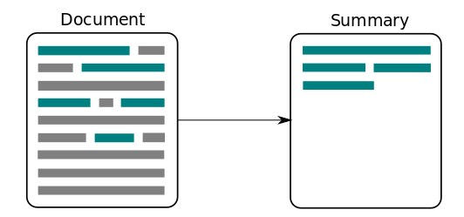

Objective
Based on the problems formulated, the objectives are
To identify the most important information from the given text and present it to the end users.
To develop a meaningful and coherent summary.
To give a summary of the video file.
To give a summary of the audio file.
To give named entities, nouns, and verbs.

Slide 5
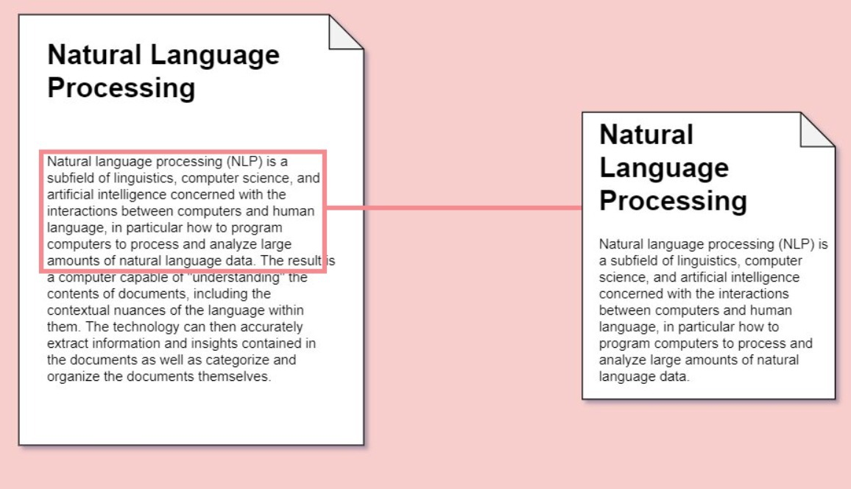
Constraints
Extracted sentences usually tend to be longer than average. Due to this, parts of the segments that are not essential for summary also get included, consuming space.
Important or relevant information is usually spread across sentences, and extractive summaries cannot capture this (unless the summary is long enough to hold all those sentences)

Slide 6
Purpose of the Work
Our purpose is to develop a meaningful and coherent summary to recapitulate highlights of the text.
There are 2 types of summarization: extractive and abstractive, in this Project we proposed extractive summarization.
PROPOSED SOLUTION:
Extractive summarization:
The extractive approach basically first selects various and unique sentences/sections of the text/document then combines them to form a summary. These sentences are selected on the basis of accurate highlights/scores described as the importance of the sentences.
Using this approach, we could produce the relevant summary with a ratio of text to a summary as 2:1 or even better.
WORKING:
The procedure is Text->Text-Processing->Summary
where text is the input, text-processing is the intermediatory step & summary is the final output.

Slide 7
Purpose of the Work
1. Text Processing
Split the paragraph into sentences.
Find the stop words in the sentences.
Remove the stop words in the sentences.
2. Word Frequency Table
Find the occurrence of each word
How many times each word appears in the document
Create a dictionary of words and their count
Using non-stop words.
3. Score each sentence
Find the maximum word frequency in the table
Give the score of each sentence based on frequency of words
By using non-stop words in our word frequency table
4. Build summary
Find the top N sentence with largest score
Finally, join the top sentences.

Slide 8
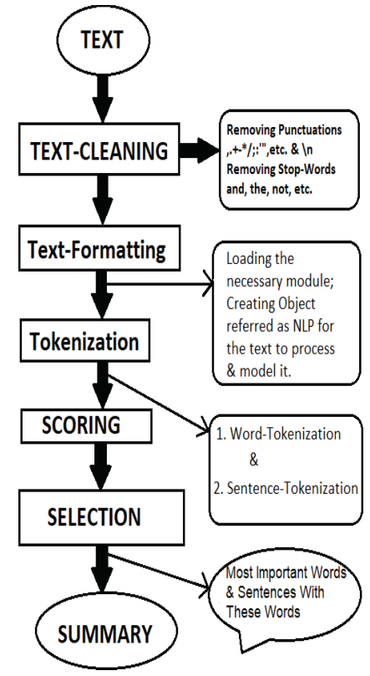
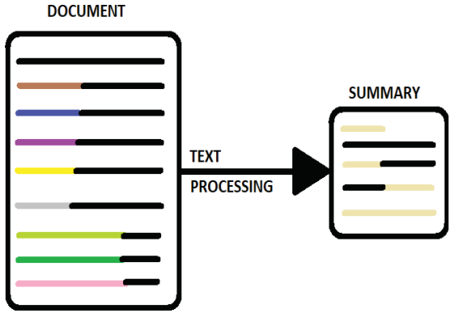
Purpose of the Work
Architecture Diagram:
Schematic Diagram:

Slide 9

Conceptual Design
FUNCTIONAL DECOMPOSITION:
Welcome page
Home Page
Summary page
Screenshots of Proposed Design:
localhost:8080

Slide 10
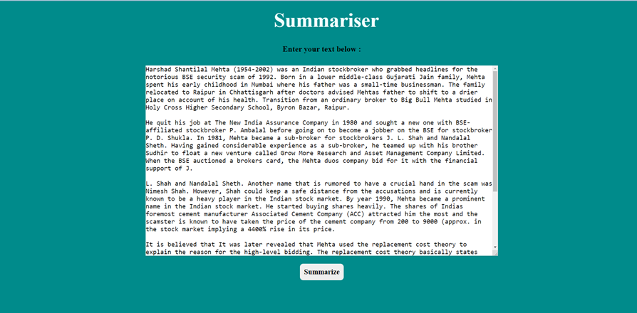
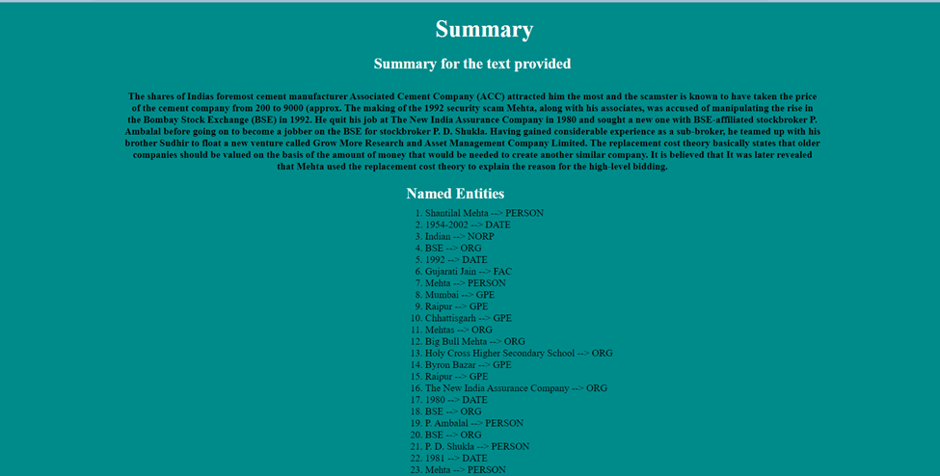
Conceptual Design

Slide 11


Conceptual Design

Slide 12
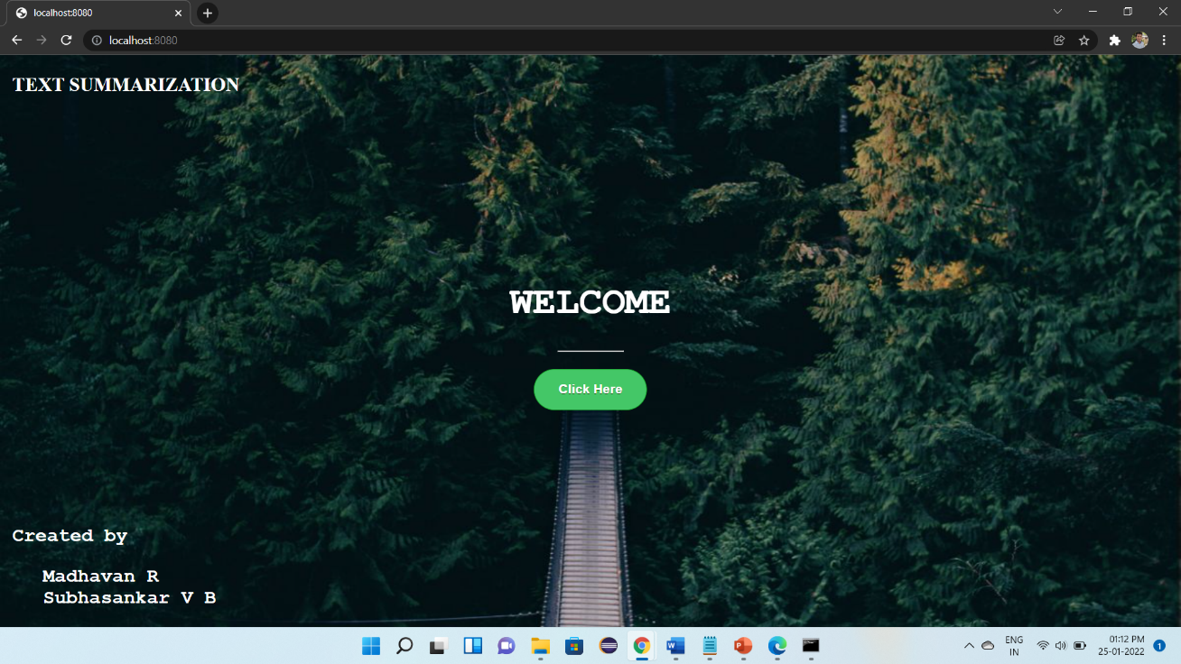
Result and Discussion
SAMPLE SCREENSHOT:
Firstly, the web application opens up with the welcome page.

Slide 13
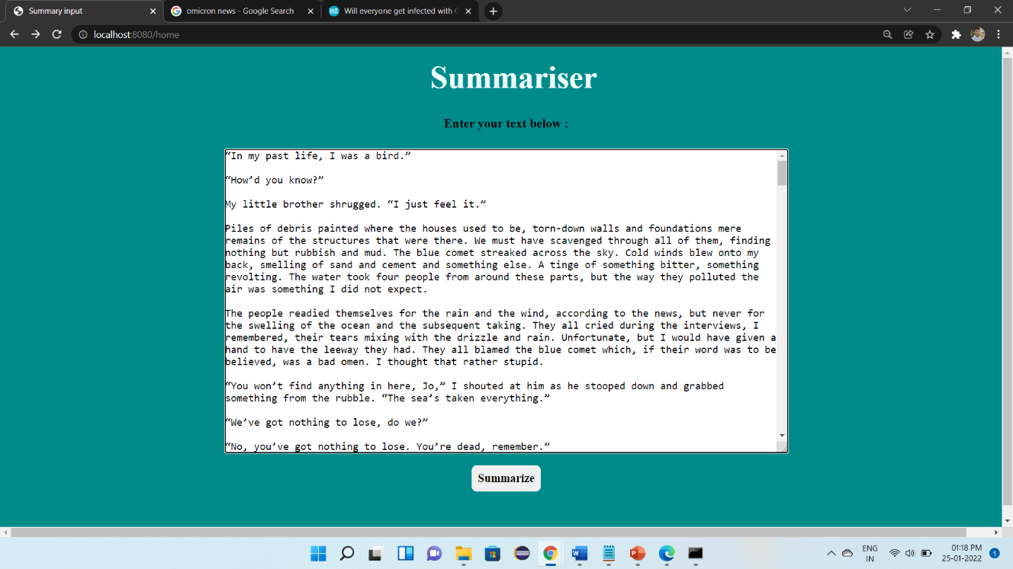
Result and Discussion
User should copy the text and paste in the text area and summarize button

Slide 14
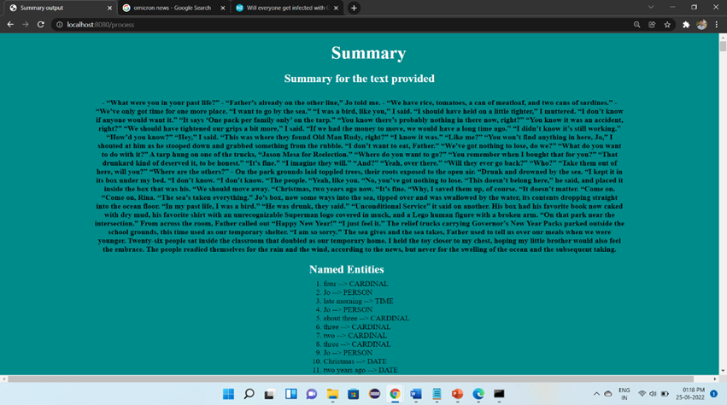
Result and Discussion
Summary will be displayed along with named entities, nouns, verbs.

Slide 15
Result and Discussion
SAMPLE INPUT:
Harshad Shantilal Mehta (1954-2002) was an Indian stockbroker who grabbed headlines for the notorious BSE security scam of 1992. Born in a lower middle-class Gujarati Jain family, Mehta spent his early childhood in Mumbai where his father was a small-time businessman. The family relocated to Raipur in Chhattisgarh after doctors advised Mehtas father to shift to a drier place on account of his health. Transition from an ordinary broker to Big Bull Mehta studied in Holy Cross Higher Secondary School, Byron Bazar, Raipur.
No of words is: 83
SAMPLE OUTPUT:
Born in a lower middle-class Gujarati Jain family, Mehta spent his early childhood in Mumbai where his father was a small-time businessman.
No of words is: 22

Slide 16
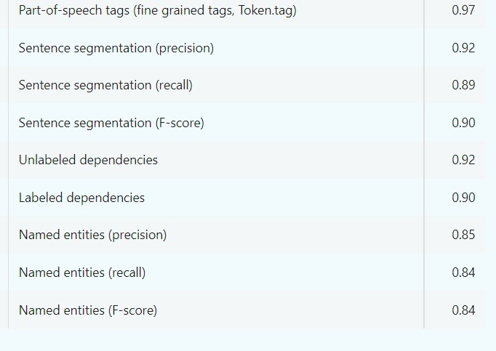
Result and Discussion
en_core_web_sm This is the pre-trained model created by the explosion

Slide 17
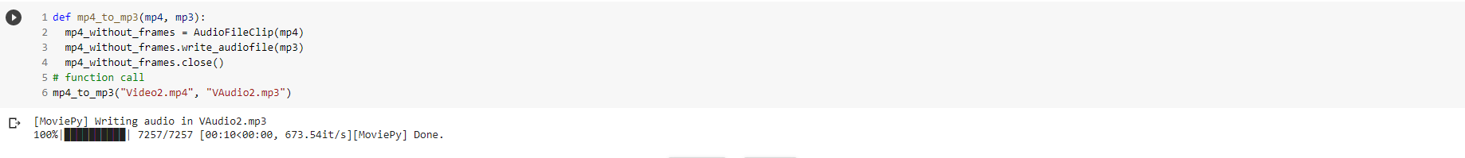
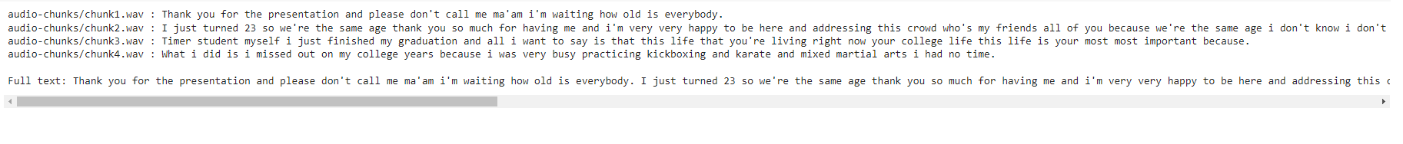
Result and Discussion
Video file to Mp3 file
Video to mp3.ipynb - Colaboratory (google.com)
Mp3 file to Text file
Colab Notebooks - Google Drive

Slide 18
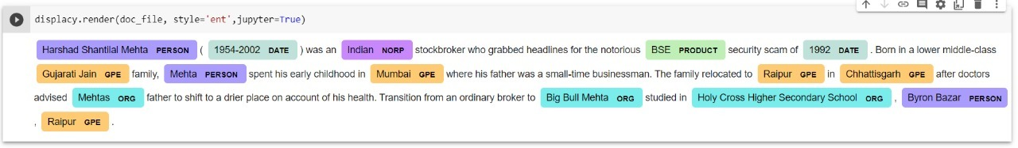
Result and Discussion
Named Entities
SpaCy.ipynb - Colaboratory (google.com)

Slide 19
Conclusion
Text summarization is an important area in NLP (Natural Language Processing) research. It consists of automatically creating a summary of one or more texts.
The purpose of extractive document summarization is to automatically select a number of indicative sentences, passages, or paragraphs from the original document .
Text summarization approaches based on Neural Network, Graph Theoretic, Fuzzy and Cluster have, to an extent, succeeded in making an effective summary of a document.
In the future we plan to contribute to improve this field by means of improving the quality of summaries, and studying the influence of other neighbor tasks techniques on summarization.

Slide 20
Thank You!

